Slide 1
Quiz on Drinking Water Treatment

Slide 2
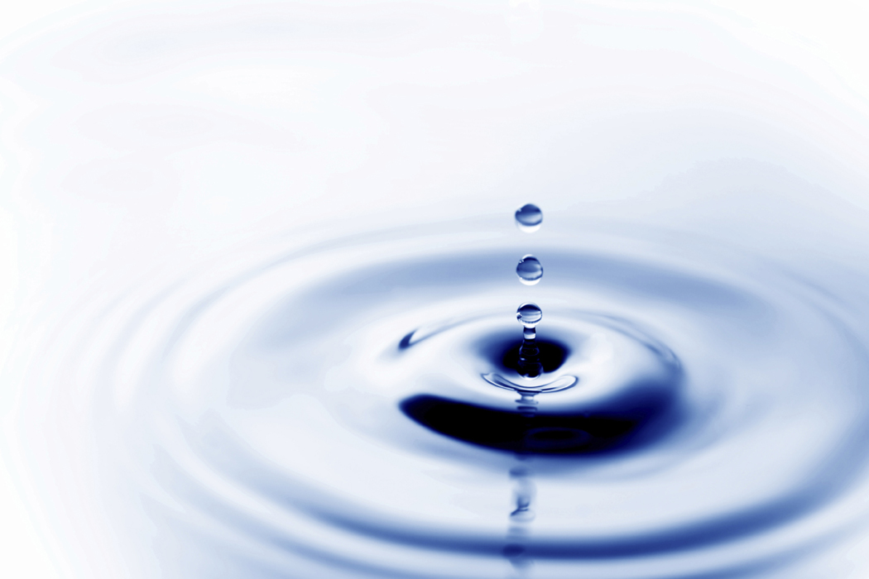
1. According to the water supply department, drinking water in a modern city should be
(I) only
Clean
Odourless
Wholesome
Bacteria-free
(I) & (II) only
(I), (II) & (III)
(I), (II), (III) & (IV)

Slide 3
2. Natural water is also known as
purified water.
raw water.
drinking water.
muddy water.

Slide 4
3. The chemically treated raw water will first be led to the
pumping station.
filtration tank.
sedimentation tank.
clarifier.

Slide 5
4. Why is it necessary to retain the chemically treated water in the clarifier?
This can kill the bacteria in water.
This can remove large impurities in water.
Allow settlement of large suspended particles in water.
This can remove small particles in water.

Slide 6
5. Water will be led to the _________after passing through the clarifier.
Mixing chamber
Flocculation tank
filter
Clean water chamber

Slide 7
6. Which kind of chemical will be added into drinking water for killing micro-organisms?
chlorine
fluoride
alum
hydrated lime

Slide 8
7. Which two chemicals are used in the experiment to produce chlorine gas?
Concentrated sulphuric acid and
Sodium hypochlorite
Concentrated hydrochloric acid and
Sodium hypochlorite
Concentrated sulphuric acid and
Acidified potassium permanganate
Concentrated hydrochloric acid and
Acidified potassium permanganate

Slide 9
8. What is the colour of chlorine gas?
colourless
pale yellow-green
brown
blue

Slide 10
9. How is chlorine produced in industry?
Mixing concentrated hydrochloric acid and acidified potassium permanganate.
Electrolysis of brine.
Using concentrated sulphuric acid.
Compressing brine.

Slide 11
10. Which of the following is not a precaution for storing chlorine?
Chlorine must be stored in an enclosed room.
Places for storing chlorine should be in a prescribed distance from buildings.
Chlorine leakage sensor should be installed
Places for storing chlorine should not be exposed to direct sunlight.

Slide 12
11. How many stages are needed for adding chlorine to drinking water in water treatment process?
2 stages
3 stages
4 stages
5 stages

Slide 13
12. Which of the following is NOT the aim of first
stage dosing?
To eliminate the odour and colour of water.
To control the growth of algae.
To kill micro-organisms.
To remove ammonia and nitrogen in water.

Slide 14
13. The aim of late stage dosing is
to prevent tooth decay.
to remove impurities in water.
to help impurities settle.
to kill micro-organisms.

Slide 15
14. Which of the following is NOT the advantage of using chlorine to disinfect water?
Chlorine is an effective disinfectant.
Chlorination is a new technology.
Chlorination process is simple.
Chlorination can persist residual chlorine
level.

Slide 16
15. Which of the following is NOT the advantage of
using ozone to disinfect water?
Ozone can oxidize manganese and iron.
Ozone disinfects effectively.
The cost of ozone is cheap.
Ozone destroys organic matter.

Slide 17
16. Which of the following is NOT the advantage of
using GAC biological filter bed to disinfect water?
It can remove ammonia in water.
It can remove oxygen in water.
It can remove the odour and colour of water.
It can remove the organic matter in water.

Slide 18
17. The set fluoride level in drinking water is
0.1 milligram per litre.
0.5 milligram per litre.
1 milligram per litre.
5 milligrams per litre.

